Slide 1


<Selena Liu>
<6/25/2025>

Slide 2

Outline
Executive Summary
Introduction
Methodology
Results
Conclusion
Appendix

Slide 3
Executive Summary
Summary of methodologies
Data Collection & Wrangling: API, Wikipedia launch table, missing value replace with mean, filter, feature engineering (standardize numerical columns, one-hot categorical features).
Exploratory Data Analysis (EDA): strip plot, box plot, bar chart, line plot.
Geospatial Visualization: Folium Map, Launch Events, Proximity Analysis.
Machine-Learning Modeling: Train/Test Split, Logistic Regression. Support Vector Machine (sigmoid), Decision Tree, K-Nearest neighbors, Evaluation (LogReg/SVM, Tree/KNN).
Summary of all results
All classifiers achieved perfect recall (no landed rocket was ever missed) but differed in false-positive rates.
Decision Tree performed best (≈ 94% accuracy), cutting false alarms to one.
Next steps could include threshold tuning, ensemble methods, or richer feature engineering to drive precision even higher.

Slide 4
Introduction
Project background and context:
SpaceX advertises Falcon 9 rocket launches on its website with a cost of 62 million dollars; other providers cost upward of 165 million dollars each, much of the savings is because SpaceX can reuse the first stage. Therefore, if we can determine if the first stage will land, we can determine the cost of a launch.
Problems you want to find answers:
In this capstone, we will predict if the Falcon 9 first stage will land successfully.

Slide 5

Section 1

Slide 6
Methodology
Executive Summary
Data collection methodology:
Perform data wrangling
Perform exploratory data analysis (EDA) using visualization and SQL
Perform interactive visual analytics using Folium
Perform predictive analysis using classification models

Slide 7
Data Collection
Describe how data sets were collected.
SpaceX REST APR – JSON – DataFrame
Fetch launch records: use a “static JSON endpoint to lock in results.
Filter & Unwrap: keep only the columns we need, drop multi entries, extracted single IDs for their one-element lists, and convert to a proper date and filter by cutoff
Enrich with helper functions: looped over each ID column and call the corresponding v4 endpoint, store each new field in a global list, then built a final launch_dict and convert it to a DataFrame.
Porst-processing: filtered to only Falco 9 launches, reset flight numbers, handled missing values.
Wikipedia Web-scraping – BeautifulSoup – DataFrame
Request the static Wiki page
Locate the launch table: found all table elements, picked the table which contains the Falcon 9 launch records.
Extract column names: iterated its table header cells, clean each header string into a flat list of column names.
Parse each data row: loop over <tr> rows, detect those whose <th> is a digit. For each, pull out the <td> cells and applied helpers to get
Data & time
Booster version
Payload info
Landing status
Append each filed into a launch_dict, then built a DataFrame.

Slide 8
Data Collection – SpaceX API
Data Collection Flowcharts
Get launches
Normalize JSON
Multi-core or multi-payload?
Yes
Drop now
No
Loop rows
Call /rockets, /launchpads, /payloads, /cores
GitHub URL: https://github.com/Selenaliu357/Data-Science-Capstone---First-Stage-of-Falcon-9-Landing-Prediction/blob/main/Collecting%20Data%20By%20API.ipynb
Collect into dict
Filter Falcon 9
Final DataFrame

Slide 9
Data Collection - Scraping
Web Scraping Flowcharts
GitHub URL: https://github.com/Selenaliu357/Data-Science-Capstone---First-Stage-of-Falcon-9-Landing-Prediction/blob/main/Collection%20with%20Web%20Scraping.ipynb
Get Wiki HTML
Parse with BeautifulSoup
Row has numeric flight No.?
No
Skip
yes
Extract and Parse into dict
Convert dict to DataFrame
Filter Falcon 9
Final DataFrame

Slide 10
Data Wrangling
Describe how data were processed:
Load CSV - pd.read_csv
Missingness - % missing
Dtypes – df.dtypes
Values counts – LauchSite, Orbit and Outcome
Bad-outcome = pick indices [1,3,5,6,7] from landing_outcomes.keys()
Binary class
Success rate – df[“Class”].mean( )
Export – df.to_csv
GitHub URL: https://github.com/Selenaliu357/Data-Science-Capstone---First-Stage-of-Falcon-9-Landing-Prediction/blob/main/Data%20Wrangling.ipynb
Load CSV
Inspect dtypes
Count variables
Count LaunchSite, Orbit, Outcome
Define bad_outcomes set
Create class column
(0/1)
Export cleaned CSV

Slide 11
EDA with Data Visualization
Summarize what charts were plotted and why you used those charts
Scatter Plot: sns.catplot(x='Xvar', y='Yvar', hue='Category', data=df), we use scatter plot to show the relationship between two continuous variables at the individual-point level.
Box Plot: sns.boxplot(x='Category', y='Value', data=df), we use it to summarizes the distribution of a continuous variable for each category: median, quartiles, and outliers.
Bar Chart: sns.barplot(x='Category', y='Value', estimator='mean', data=df), it is best for aggregate comparisons—counts or summary statistics (mean, sum) per category.
Line Plot: sns.lineplot(x='TimeOrSeq', y='Metric', data=summary_df, marker='o’), it shows trends over an ordered or continuous variable (often time, flight number, etc.).
GitHub URL: https://github.com/Selenaliu357/Data-Science-Capstone---First-Stage-of-Falcon-9-Landing-Prediction/blob/main/Exploring%20and%20Preparing%20Data%20(EDA).ipynb

Slide 12
EDA with SQL
Using bullet point format, summarize the SQL queries you performed
SELECT DISTINCT
WHERE … LIKE
SUM(…), AVG(…), MIN(…), MAX(…)
GROUP BYORDER BY … DESC
Sub-query in WHERE (e.g. = (SELECT MAX(...)))
CASE … WHEN mapping for month names
substr(...) for date string slicing
GitHub URL: https://github.com/Selenaliu357/Data-Science-Capstone---First-Stage-of-Falcon-9-Landing-Prediction/blob/main/EDA%20with%20SQL.ipynb

Slide 13
Build an Interactive Map with Folium
Quick rundown of the Folium objects we added and their purposes:
MousePosition: Shows your cursor’s latitude/longitude in real time—helps you pick exact points for coastlines, cities, highways, etc.
MarkerCluster: Groups many point markers into clusters at low zoom levels to reduce clutter, then expands them as you zoom in.
Circle: Draws a solid circle (e.g. 1 km radius) around each launch site to highlight its footprint or exclusion zone, with a popup for the site name.
Marker + DivIcon: Marks each individual launch event (clustered) and color‐codes them green/red to indicate success or failure.
PolyLine: Connects two points (launch site ↔ coastline, city, highway, etc.) with a colored line, visually showing proximity relationships
We add these to Annotate key locations, Encode outcomes, Communicate distances and Improve usability.
GitHub URL: https://github.com/Selenaliu357/Data-Science-Capstone---First-Stage-of-Falcon-9-Landing-Prediction/blob/main/Interactive%20Visual%20Analytics%20with%20Folium.ipynb

Slide 14
Predictive Analysis (Classification)
Model Development Process
Load and Preprocess Data
Logistic Regression
SVM
Decision Tree
KNN
Train/Test Split for each model
GridSearchCV (cv=10)
Select Best Params & CV Scores
Compute Accuracy & Confusion Matrix
Compare Models' Test Performance
Choose Top Performer(s): DT
GitHub URL: https://github.com/Selenaliu357/Data-Science-Capstone---First-Stage-of-Falcon-9-Landing-Prediction/blob/main/Machine%20Learning%20Prediction.ipynb

Slide 15
Results
Exploratory data analysis results
We can observe that the success rate since 2013 kept increasing till 2020.
More complex or higher-energy orbits (e.g. GTO, interplanetary SO) show lower landing success—reflecting the extra challenge of those mission profiles.
SpaceX’s booster landing success rate improved steadily with each new flight, and all three pads ended up with very high success rates by around flight 50+.
Interactive analytics demo in screenshots
The launch success rate may depend on many factors such as payload mass, orbit type, and so on. It may also depend on the location and proximities of a launch site.
Predictive analysis results
Decision Tree performed best (≈ 94% accuracy), cutting false alarms to one.

Slide 16

Section 2

Slide 17
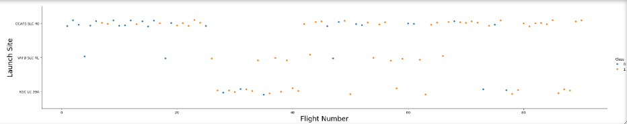
Flight Number vs. Launch Site
Scatter plot of Flight Number vs. Launch Site
Explanations:
* SpaceX’s booster landing success rate improved steadily with each new flight,
* and all three pads ended up with very high success rates by around flight 50+.

Slide 18
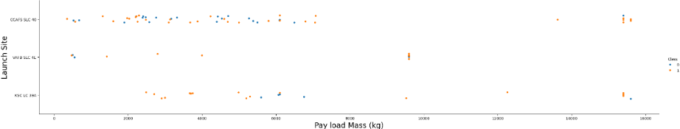
Payload vs. Launch Site
Scatter plot of Payload vs. Launch Site
Explanations:
Payload Mass Vs. Launch Site scatter point chart for the VAFB-SLC launchsite there are no rockets launched for heavypayload mass(greater than 10000).

Slide 19
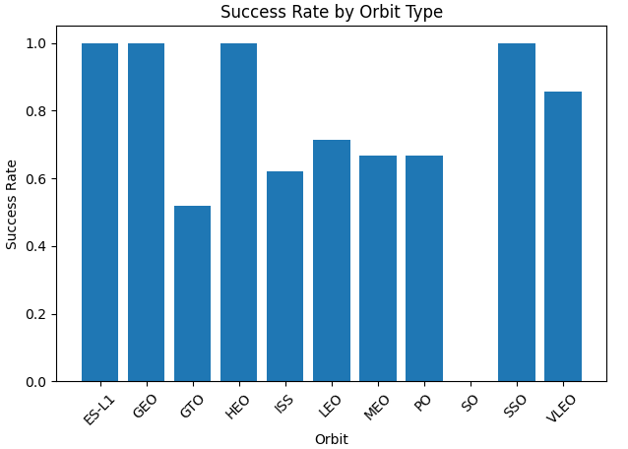
Success Rate vs. Orbit Type
Explanations:
Orbits with 100 % success: ES-L1, GEO, HEO, SSO
High but not perfect: VLEO (~85 %) and LEO (~70 %)
Moderate success: ISS (~62 %), MEO/PO (~67 %)
Lowest success: GTO (~52 %) and SO (0 %)
Buttom Line: More complex or higher-energy orbits (e.g. GTO, interplanetary SO) show lower landing success—reflecting the extra challenge of those mission profiles.

Slide 20
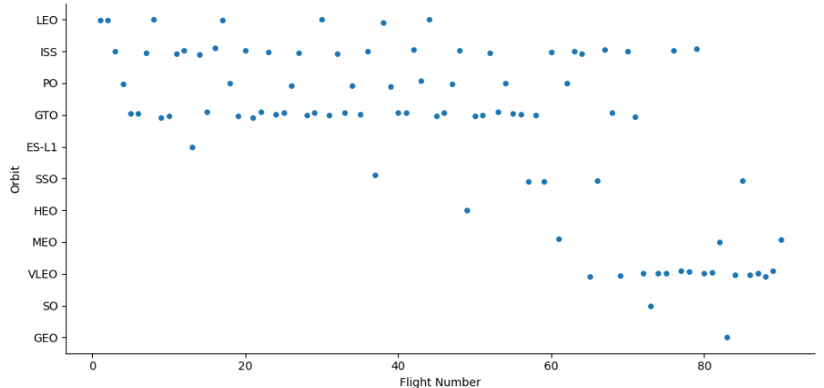
Flight Number vs. Orbit Type
Scatter point of Flight number vs. Orbit type
Explanations:
We can observe that in the LEO orbit, success seems to be related to the number of flights. Conversely, in the GTO orbit, there appears to be no relationship between flight number and success.

Slide 21
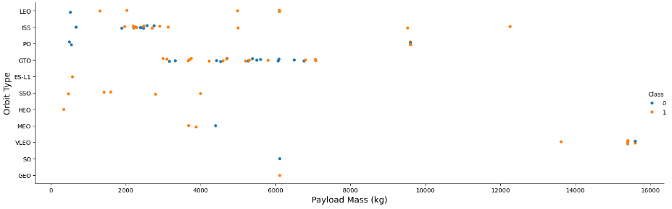
Payload vs. Orbit Type
Scatter point of payload vs. orbit type
Explanations:
With heavy payloads the successful landing or positive landing rate are more for Polar, LEO and ISS. However, for GTO, it's difficult to distinguish between successful and unsuccessful landings as both outcomes are present.

Slide 22
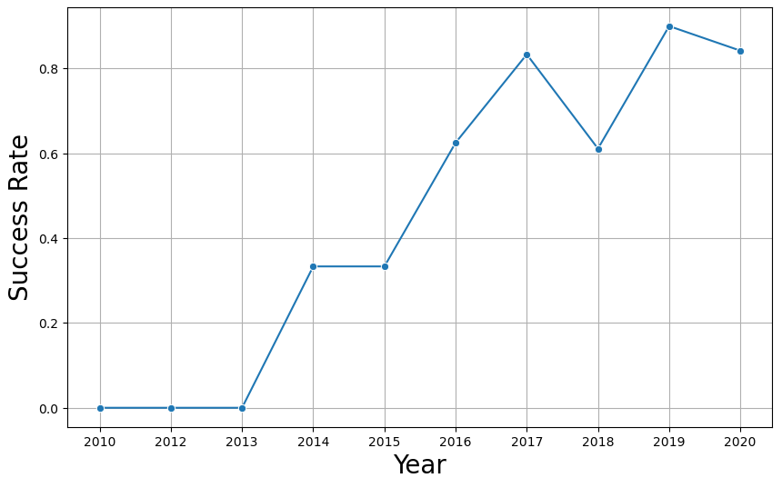
Launch Success Yearly Trend
Explanations:
We can observe that the success rate since 2013 kept increasing till 2020.

Slide 23
All Launch Site Names
The names of the unique launch sites:
CCAFS LC-40
VAFB SLC-4E
KSC LC-39A
CCAFS SLC-40
Explanation:
There are four unique launch sites in the space mission.

Slide 24
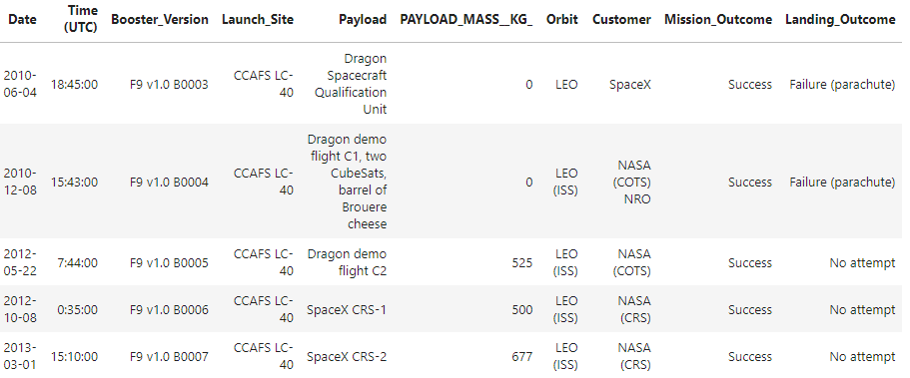
Launch Site Names Begin with 'CCA'
Five records where launch sites begin with `CCA`
Explanation:
There are more that 5 recorts where launch sites begin with ‘CCA’

Slide 25
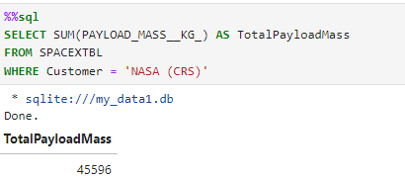
Total Payload Mass
Total payload carried by boosters from NASA:
Explanation:
The total payload carried by boosters from NASA is 45596.

Slide 26
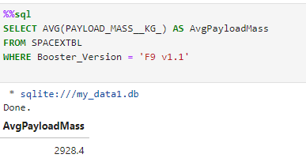
Average Payload Mass by F9 v1.1
The average payload mass carried by booster version F9 v1.1
Explanation:
The average payload mass carries by booster version F9 v1.1 is 2928.4.

Slide 27
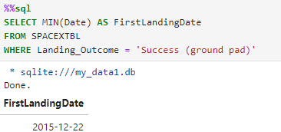
First Successful Ground Landing Date
The dates of the first successful landing outcome on ground pad
Explanation:
The date of first successful landing outcome in ground pad is 2015-12-22.

Slide 28
Successful Drone Ship Landing with Payload between 4000 and 6000
The names of boosters which have successfully landed on drone ship and had payload mass greater than 4000 but less than 6000
F9 FT B1022
F9 FT B1026
F9 FT B1021.2
F9 FT B1031.2
Explanation:
There are four boosters which have successfully landed on drone ship and had payload mass greater than 4000 but less than 6000.

Slide 29
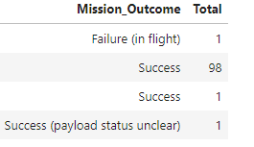
Total Number of Successful and Failure Mission Outcomes
Calculate the total number of successful and failure mission outcomes
Explanation:
There are 4 distinct categories for Mission_Outcome.

Slide 30
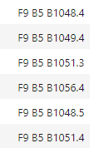
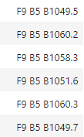
Boosters Carried Maximum Payload
The names of the booster which have carried the maximum payload mass

Slide 31
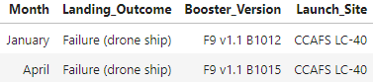
2015 Launch Records
The failed landing_outcomes in drone ship, their booster versions, and launch site names for in year 2015
Explanation:
There are two failed landing_outcomes in drone ship, their booster versions, and launch site names for in year 2015.

Slide 32
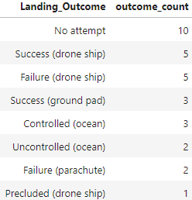
Rank Landing Outcomes Between 2010-06-04 and 2017-03-20
Rank the count of landing outcomes (such as Failure (drone ship) or Success (ground pad)) between the date 2010-06-04 and 2017-03-20, in descending order

Slide 33

Section 3

Slide 34
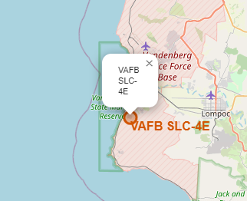
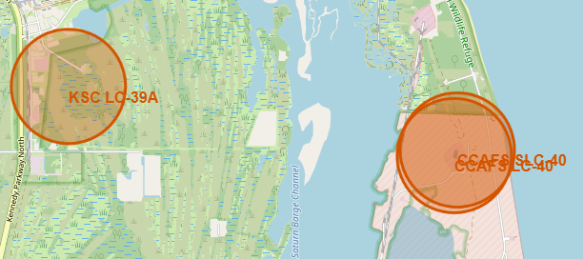
<Mark all launch sites on a map>
All four markers lie on or very near major bodies of water: CCAFS SLC-40 & KSC LC-39A on barrier islands beside the Atlantic; VAFB SLC-4E on the Pacific coast. This coastal siting is deliberate: rockets launch over open water and (for SpaceX) boosters can return to sea or shore without overflying populated areas.

Slide 35
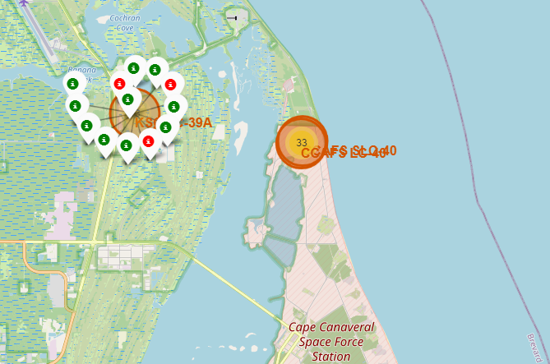
< Mark the success/failed launches for each site on the map >
The map from left shows the launch sites have relatively high success rate.

Slide 36
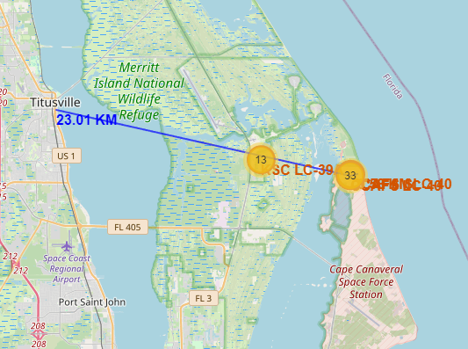
< The distances between a launch site to Titusville, FL >
Map chart from left shows the distance between one of launch sites in close to city – Titusville, FL.

Slide 37

Section 5

Slide 38
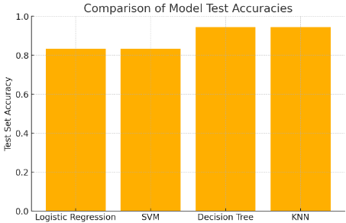
Classification Accuracy
Visualize the built model accuracy for all built classification models, in a bar chart
Both Decision Tree and KNN model have the highest classification accuracy (~0.94)

Slide 39
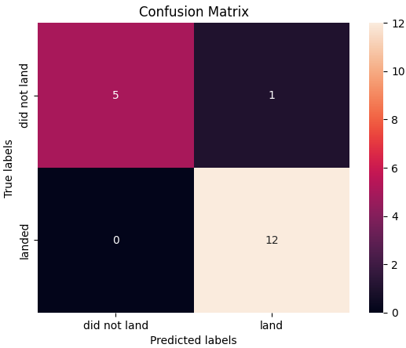
Confusion Matrix
Confusion matrix of the best performing model:
The Decision Tree model reduce the number of false alarms from 3 down to 1 (and still never miss a true landing), giving them the highest overall accuracy (≈94 %)

Slide 40
Conclusions
Logistic Regression
Test accuracy ≈ 0.83, False positives = 3, false negatives = 0
SVM
Test accuracy ≈ 0.83, False positives = 3, false negatives = 0
Decision Tree
Test accuracy ≈ 0.94, False positives = 1, false negatives = 0
KNN
Test accuracy ≈ 0.94, False positives = 1, false negatives = 0
Conclusion: Both the Decision Tree and KNN models reduce the number of false alarms from 3 down to 1 (and still never miss a true landing), giving them the highest overall accuracy (≈94 %). By that metric, they outperform Logistic Regression and SVM on this test set

Slide 41


